Slide 1
TiTLi
Full-Text Search on Relational Databases
Juber Patel (0522)
For
Persistent Systems Private Ltd.

Slide 2
Contents
TiTLi
Lucene
Work so far
Future plans

Slide 3
TiTLi
A Google-like search tool for databases
3 different forms
  A general API
  An embedded component
  A standalone application with Web-based UI
Uses Apache Lucene for indexing and searching

Slide 4
Lucene
Lucene : an Indexing and search engine
A Jakarta project, for Java
Many search features
  Ranked searching
  Multiple index searching
  Fielded searching (e.g., title, author, contents)

Slide 5
Lucene (contd.)
Many powerful query types
  phrase queries
  wildcard queries
  proximity queries
  range queries and more
Sorting by any field
Stop words

Slide 6
Work so far

Slide 7
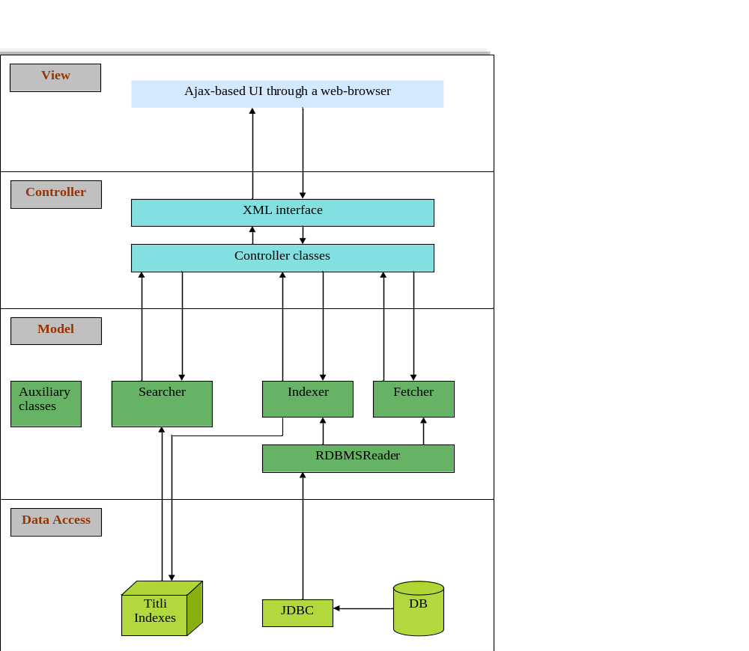
TiTLi Architecture Diagram

Slide 8
TiTLi Architecture
Model-View-Controller Design Pattern
Data Access
  TiTLi Indexes : to store indexing info
  Databases : to be indexed and searched
Model
  Indexer : performs indexing of databases
  Searcher : performs a search on the indexes
  Fetcher : fetches the selected records from the databases

Slide 9
TiTLi Architecture (contd.)
Controller
  Controller interfaces
  XML interface
View
  Ajax-based web page for a responsive, rich UI with asynchronous loading of data

Slide 10
Future Plans

Slide 11
Creating Independent UI With GWT
Google Web Toolkit
  Ajax Toolkit
  Open source
  Write, test, debug and maintain in Java

Slide 12
Thank You

